Slide 1

Healthy, Hunger-Free Kids Act of 2010
National School Lunch & School Breakfast Programs
Meal Patterns
Offer vs. Serve
After School Snack
Meal or No Meal

Slide 2
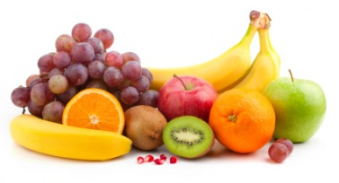
FRUITS
 | Breakfast |  |  | Lunch
Grades | K-5 | 6-8 | 9-12 | K-5 | 6-8 | 9-12
Meal Pattern | Amount of food per week (Minimum per day)
Fruits (cups) | 5 (1) | 5 (1) | 5 (1) | 2½ (½) | 2½(½) | 5 (1)
SY 2014-15
Fresh, canned in 100% fruit juice or light syrup, frozen, dried or 100% fruit juice
  No more than HALF of fruit offerings per WEEK may be juice
  ¼ cup dried fruit = ½ cup eq. of fruit offering

Slide 3
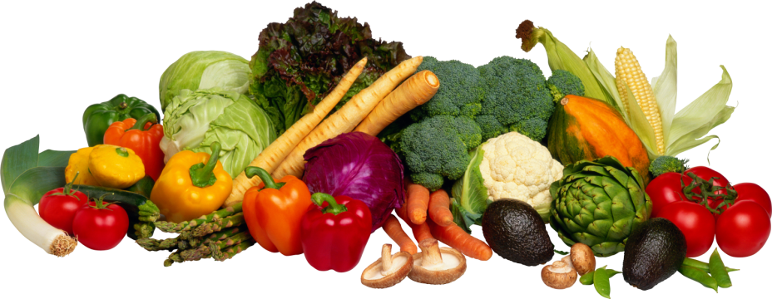
VEGETABLES
 | Lunch
Grades | K-5 | 6-8 | 9-12
Meal Pattern | Amount of food per week (Minimum per day)
Vegetables (cups) | 3 ¾ (¾) | 3 ¾ (¾) | 5 (1)
Dark green | ½ | ½ | ½
Red/Orange | ¾ | ¾ | 11/4
Beans/Peas (Legumes) | ½ | ½ | ½
Starchy | ½ | ½ | ½
Other | ½ | ½ | ½
Additional Veg. to Reach Total | 1 | 1 | 1 ½

Slide 4
VEGETABLE SUBGROUPS
Red/Orange | acorn squash, butternut squash, carrots, pumpkin, tomatoes, tomato juice & sweet potatoes
Beans/Peas (Legumes) | black beans, black-eyed peas (mature, dry), garbanzo beans (chickpeas), kidney beans, lentils, navy beans, pinto beans, refried beans, soy beans, split peas, vegetarian beans & white beans
Dark Green *NOTE: 1 CUP leafy greens = 1/2 cup vegetable serving | bok choy, broccoli, collard greens, dark green leafy lettuce, kale, mesclun, mustard greens, romaine lettuce, spinach, turnip greens* & watercress
Starchy | black-eyed peas (not dry), corn, cassava, green bananas, green peas, green lima beans, plantains, taro, water chestnuts, jicama, & white potatoes
Other | Other vegetables, such as artichoke, asparagus, avocado, bean sprouts, beets, Brussels sprouts, cabbage, cauliflower, celery, cucumbers, eggplant, green beans, green peppers, iceberg lettuce, mushrooms, okra, onions, parsnips, turnips, wax beans, & zucchini. Requirement may be met with any extra amounts from the Dark Green, Red/Orange or Beans/Peas (Legumes) Vegetable subgroups.
Add'l Veg to Reach Total | Any vegetable subgroup may be offered to meet the total weekly vegetable requirement.

Slide 5

VEGETABLES
Fresh, frozen, or canned vegetables and dry beans/peas (legumes)
1 cup leafy greens = ½ cup eq. veg offering
Beans/Peas (Legumes) may be credited as vegetable OR meat/meat alternates

Slide 6
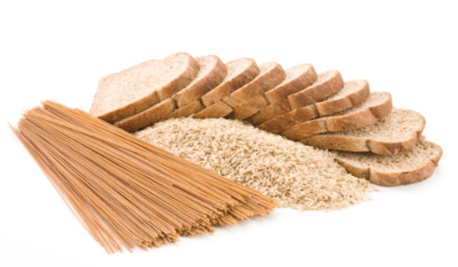
GRAINS
 | Lunch
Grades | K-5 | 6-8 | 9-12
Meal Pattern | Servings Per Week (Minimum per day)
Grains (oz-eq) | 8-9* (1) | 8-10* (1) | 10-12 *(2)
SY 2012-2013, at least HALF grains offered must be whole grain-rich (WGR)
SY 2014-2015, ALL grains offered must be WGR
WGR foods contain at least 50% whole grains
Two grain servings/week can be grain-based desserts
*Max. # of serving has been removed.

Slide 7
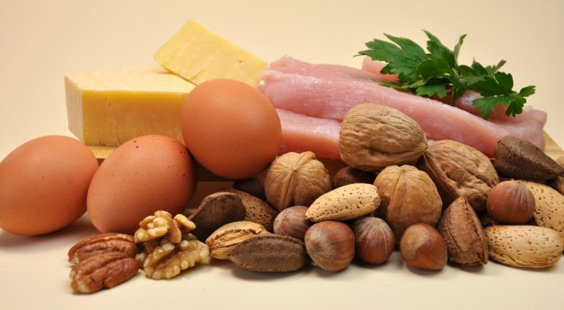
MEAT/MEAT ALTERNATES
 | Lunch
Grades | K-5 | 6-8 | 9-12
Meal Pattern | Amount of Food Per Week (Min. per day)
Meat/Meat Alternates (oz. eq) | 8-10* (1) | 9-10* (1) | 10-12* (2)
*Max. # of serving has been removed.

Slide 8
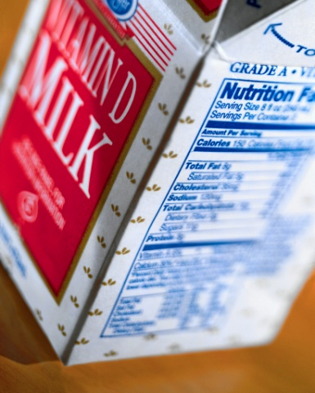
FLUID MILK
Grades K-12 must be offered 1 cup (8 fl.oz.) of milk per meal.
Allowable Milk Choices:
  Fat-Free unflavored or flavored milk
  Low Fat unflavored milk
  Fat-Free or Low Fat lactose-reduced or lactose-free milk
Must offer two choices
  AUHSD and ACSD: unflavored 1% , Fat-Free, and Fat Free Lactose Free.

Slide 9
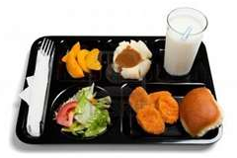
LUNCH OFFER VS. SERVE
Five meal components must be offered
  Fruits
  Vegetables
  Grains
  Meat/Meat Alternates
  Milk
Two of the five meal components can be declined by the student
*Student MUST take at least ½ cup of fruit or vegetable

Slide 10

LUNCH OFFER VS. SERVE
For Grades 9-12, if a student selects the following
  Fruit (½ cup)
  Vegetable (½ cup)
  And one other component
  (Grain, Meat, or Milk)
then the student MUST take the FULL of fruit or vegetable serving (1 cup). The student need to take one of the following in addition
  Fruit (½ cup)
  Vegetable (½ cup)

Slide 11

BREAKFAST OFFER VS. SERVE
Three food components must be offered
  Grains
  Fruits
  Milk
Meat/ Meat Alternate (M/MA)
  Substitution for Grain (G)
  Substitute 1oz. eq. M/MA for 1 oz. eq. G after 1 oz. eq. G is offered.
Vegetable
  Substitution for Fruit
  First two cups per week must be from the Dark Green, Red/Orange, Bean/Peas/Legumes or Other Vegetables subgroups.
At least 4 food items must be offered
Student must take at least 3 food items

Slide 12
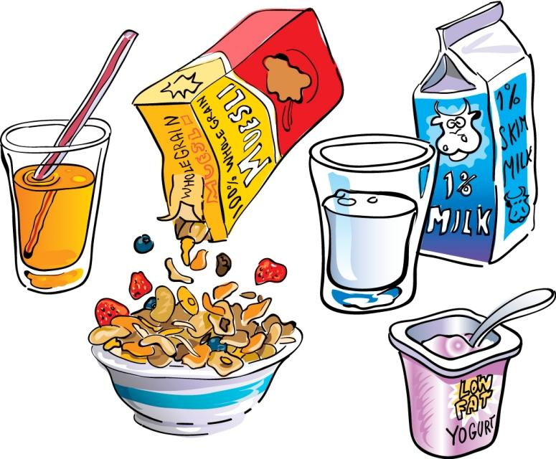
BREAKFAST OFFER VS. SERVE
Food Item
  Food items are foods that are offered to provide the food component.
  One or more food items may provide the required quantity of the food component.
    Fruit juice (4 fl. oz.)+ fresh fruit(½ cup), Fruit component:
      one food item + one food item
    Cereals, Grain component:
      1 oz. serving: one food item
      2 oz. serving: two food items

Slide 13
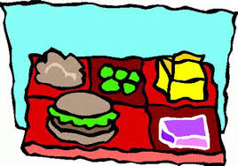
BREAKFAST OFFER VS. SERVE
Menu Item
  Menu item now refers to a food or combination of foods as listed on a menu.
  A menu item may contain one or more food items and/or food components.
    Pancake & Turkey wrap:
    one grain food item + one meat food item
    Cinnamon Waffle:
      two grain food item

Slide 14
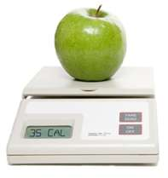
CALORIES, SODIUM, and FAT (TRANS & SAT.)
 | Breakfast |  |  | Lunch
Grades | K-5 | 6-8 | 9-12 | K-5 | 6-8 | 9-12
Min-Max Calories | 350-500 | 400-550 | 450-600 | 550-650 | 600-700 | 750-850
Sodium (mg) | ≤540 | ≤600 | ≤640 | ≤1,230 | ≤1,360 | ≤1,420
SY 2014-15
ZERO grams of trans fat per serving
<10% of calories from saturated fat per week

Slide 15

After School Snack Program
After School Snack Program
  Federally Reimbursable Programs
    May be Under NSLP or CACFP
  Administered by California Department of Education (CDE).
    21st Century Community Learning centers programs
    CDE’s After School Education and Safety programs
  Must meet following Nutrition Standards
  Federal reimbursable snack requirements
  California Education Code requirements

Slide 16

After School Snack Program
Nutrition Standards
California Education Code Requirements
  Each individual Food item
    May be deep fried, par fried, or flash fried as part of manufacturing process in acceptable oil, typically liquid at room temperature.
    May not contain artificial trans fat
    ≤ 35% of total calories from fat
    ≤ 10% of total calories from saturated fat
    ≤ 35% of total weight from sugar
    ≤ 175 calories for Grades K-6
    ≤ 250 calories for Grades 7-12
  Above standards do not apply to legumes, fruits, vegetables, or individually packed nuts, seeds, and eggs.
  Whole grain products are highly recommended.

Slide 17

After School Snack Program
Nutrition Standards
Federal Reimbursable Snack Requirements
  Full servings of any 2 of the following 4 food components:
    Fluid Milk (8 fl. oz.)
    Fruit, Vegetable, or 100 percent Juice (¾ cup eq.)
    Grain (1oz. eq.)
    Meat or Meat Alternate (1oz. eq.)
  Juice may not be served when milk is the only other component.

Slide 18
I have completed the training for Breakfast and Lunch Meal Patterns, Offer vs. Serve, After School Snack, and Meal or No Meal.
School Name:
Training Sign off
Print Name | Signature | Date

Slide 19
I have completed the training for Breakfast and Lunch Meal Patterns, Offer vs. Serve, After School Snack, and Meal or No Meal.
School Name:
Training Sign off
Print Name | Signature | Date

